Slide 1


Feature Extraction and Price Prediction for Mobile Phones
Gaurav Kumar

Slide 2
Introduction
Welcome to our presentation on "Mobile Phone Price Prediction and Feature Analysis," a project aimed at enhancing our organization's pricing strategy in the highly competitive mobile phone market.
Background: In today's dynamic marketplace, understanding the factors that influence mobile phone prices is crucial for staying ahead of the competition. As part of our commitment to excellence, we embarked on a data-driven journey to build a predictive model that accurately estimates mobile phone prices based on their features.
Objective: Our primary goal is to provide our organization with valuable insights into the key features that significantly impact mobile phone prices. By leveraging advanced analytics and machine learning, we aim to develop a predictive model that not only enhances our pricing strategy but also empowers us to make informed marketing decisions.

Slide 3
Project Overview
Project Tasks:
Data Exploration: We began by delving into a comprehensive dataset containing detailed information about various mobile phones. This dataset encompasses crucial attributes such as model, color, memory, RAM, battery capacity, camera specifications, and, most importantly, price.
Data Preprocessing: To ensure the reliability of our analysis, we meticulously handled missing values, outliers, and converted categorical variables into a numerical format using techniques like one-hot encoding.
Feature Extraction: Leveraging statistical methods, visualizations, and machine learning techniques, we identified the most influential features that strongly affect mobile phone prices.
Model Building: Our journey extended to the development of a predictive model for mobile phone prices. We explored algorithms such as linear regression, decision trees, and advanced models like random forests to achieve accurate predictions.
Model Evaluation: The performance of our model was rigorously evaluated using industry-standard metrics like Mean Absolute Error (MAE) and Root Mean Squared Error (RMSE), providing us with insights into its accuracy.

Slide 4
Project Overview
Project Tasks:
Feature Importance Analysis: To confirm the significance of our identified features, we conducted a thorough analysis of feature importance derived from our machine learning model.
Dashboard Creation Using Tableau: We harnessed the power of Tableau to create an interactive and dynamic dashboard, visually representing key aspects of our project.
Dataset Overview: Our dataset comprises a wealth of information crucial for our analysis. Each entry includes details about mobile phone models, colors, specifications, and, notably, their prices. The diversity and richness of this dataset form the foundation of our exploration into the complex dynamics of mobile phone pricing.
Importance of Understanding Key Features: In a market where consumer choices are influenced by an array of features, understanding the factors that drive mobile phone prices is paramount. By unraveling the intricacies of these key features, we position ourselves to make informed decisions, refine our pricing strategies, and ultimately gain a competitive edge in the ever-evolving mobile phone industry.

Slide 5
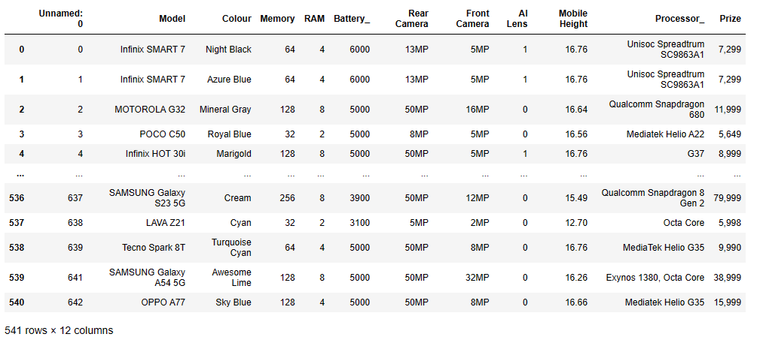
Data Exploration
Snapshot of Raw Data:
Our journey begins with a snapshot of the raw data, a wealth of information about various mobile phones.
The dataset comprises 541 rows and 12 columns, encompassing essential attributes such as model, color, memory, RAM, battery capacity, and more.
Data Types and Shape:
The data types available include objects and integers, providing a diverse range of information.
This diversity is reflected in the dataset's shape, emphasizing its richness and complexity.
Column: Unnamed: 0:
Notably, there is a column labeled "Unnamed: 0," which solely contains index numbers.
This column serves as an index and, upon closer inspection, reveals itself as unnecessary for our analysis.
Note: As we progress, we will address and streamline the data, ensuring its cleanliness and relevance to our exploration.

Slide 6
Data Preprocessing
Steps taken to handle missing values, outliers, and categorical variables:
Dropped unnecessary column : As discussed in the previous slide, we have dropped an unnecessary column labelled as Unnamed: 0.
Checked Null Value: Used “isnull().sum()” function to see if there is any null value in the dataset. There were not null values.
Dataset Information: Used “info()” function to see the data type of each column. It was observed that Price column was having object data type instead of integers. Upon investigation it was found that commas (,) used in data was causing this issue. Used another function i.e., .replace(‘ , ’ , ’ ’) to replace all the commas with nothing.
Created new features using existing ones : Used split function to create “Brand” and “Processor Brand” columns from “Model” and “Processor_” columns.

Slide 7
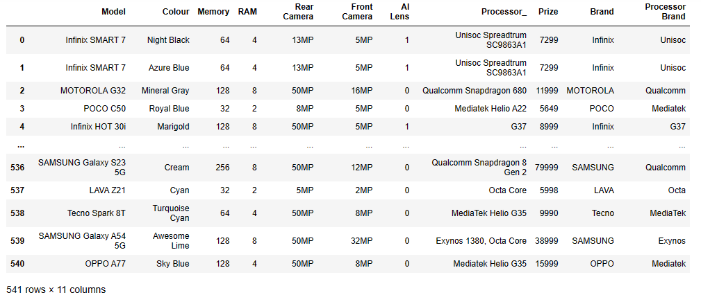
Data Preprocessing
Steps taken to handle missing values, outliers, and categorical variables:
Outliers : Used Boxplots to find out the outliers. There were so many outliers in Batter and Mobile Height. Removed these columns from the dataset.
Final Dataset : Below is the snapshot of the transformed dataset .

Slide 8
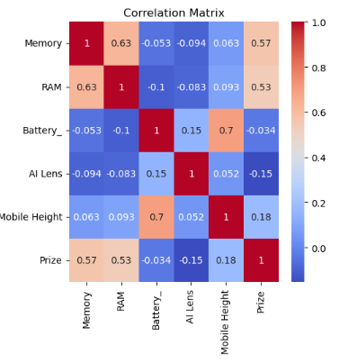
Feature Extraction
Correlation Matrix: Used heatmap to see the correlation of other features with price. It was found that Memory and RAM are the most relevant features that strongly affect the price of mobile phones.

Slide 9
Model Building
Deployment of various model: A diverse array of models was employed to pinpoint the optimal fit for this specific dataset. Through rigorous experimentation, we sought to identify the model that aligns most seamlessly with the intricate patterns and characteristics embedded in our data. This comprehensive approach allows us to leverage the strengths of different models, ensuring a robust foundation for our predictive analysis tailored to the nuances of our dataset.
Deployed model:
Linear Regression Model
Linear Regression Model augmented with Principal Component Analysis (PCA)
Decision Tree and Random Forest Model
Support Vector Machine Model
K-Nearest Neighbors (KNN) Model

Slide 10
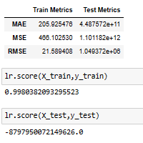
Model Evaluation
We evaluated multiple models using One-Hot Encoding on the dataset, assessing their performance with key metrics: MAE, MSE, RMSE, and R-squared scores. These metrics offer a concise overview of each model's predictive accuracy and explanatory power, providing valuable insights into their effectiveness in handling categorical features.
Linear Regression Model : Mean Absolute Error, Mean Squared Error, Root Mean Squared Error and the R-squared score for train and test dataset are not desirable.

Slide 11
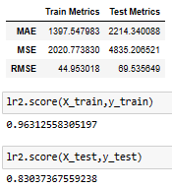
Model Evaluation
Linear Regression Model augmented with Principal Component Analysis (PCA): Here, the R-squared score for train and test dataset is good. However, Mean Absolute Error, Mean Squared Error, Root Mean Squared Error and are not satisfactory.

Slide 12
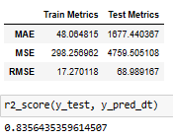
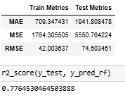
Model Evaluation
Decision Tree and Random Forest Model: Here also Mean Absolute Error, Mean Squared Error, Root Mean Squared Error are not desirable. However, the R-squared score is good.

Slide 13
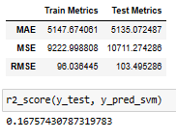
Model Evaluation
Support Vector Machine (SVM) Model : Here also Mean Absolute Error, Mean Squared Error, Root Mean Squared Error and the R-squared score for train and test dataset are not desirable

Slide 14
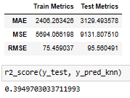
Model Evaluation
K-Nearest Neighbors (KNN) Model : Here also Mean Absolute Error, Mean Squared Error, Root Mean Squared Error and the R-squared score for train and test dataset are not desirable

Slide 15
Feature Importance Analysis
Significance of Top Features:
Memory and RAM emerge as the most relevant features, playing a pivotal role in predicting mobile phone prices.
Delve into the specifics of how these features contribute to the overall accuracy of our model and their impact on pricing.

Slide 16
Conclusion
Upon employing various models on the dataset encoded using One-hot encoder, it was observed that the Linear Regression Model, particularly when augmented with Principal Component Analysis (PCA), emerges as the optimal fit for this specific dataset

Slide 17
Thank you!

